Slide 1


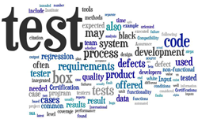
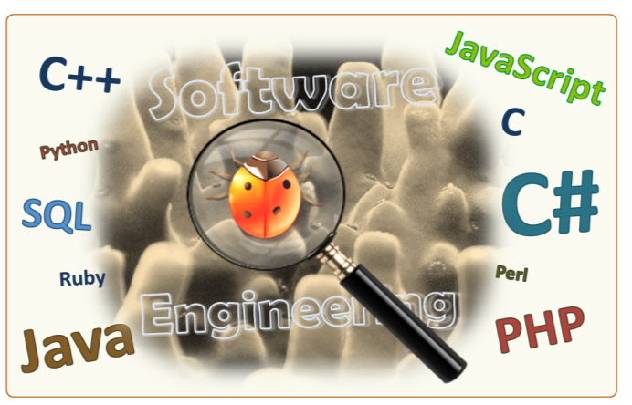
Software Quality Assurance
QA Engineering, Testing, Bug Tracking, Test Automation
Svetlin Nakov
Technical Trainer
www.nakov.com
Software University
http://softuni.bg

Slide 2
Table of Contents
Software Quality Assurance – Overview
Software Testing, Test Scenarios, Test Cases
Defect Reporting and Tracking
Defect Lifecycle
Defect Tracking Systems
Test Automation
Web Testing, Service Testing, Load Testing, UI Testing

Slide 3
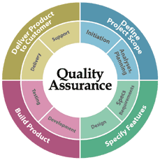
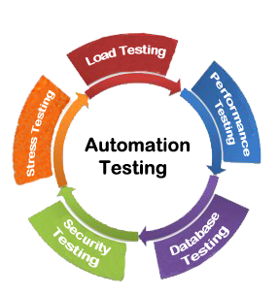
Software Quality Assurance

Slide 4

Software Quality Assurance
What is software quality assurance (SQA)?
Software quality assurance aims to assure that the software is bug free (behaves as expected)
Defects are reported and tracked through a bug tracking system
Performed by the Quality Assurance Engineers (QA engineers)
Most of the QA work is software testing
Manual testing (click and check the results)
Automated testing (QA automation)

Slide 5
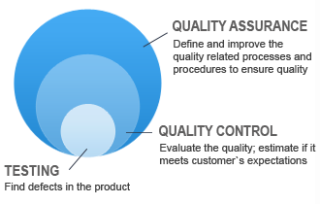
The Software QA Process
QA planning / test planning
Establish test strategy and test plan
What to test, how to test it, when, test scenarios
Test development
Test procedures, test scenarios, test cases, test scripts
Test execution and reporting
Defect tracking

Slide 6
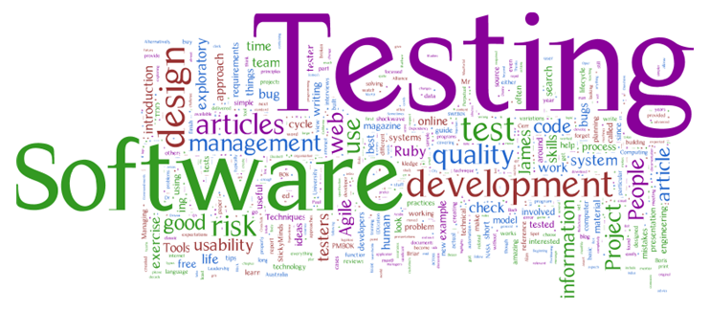
Software Testing
Testing checks whether the developed software conforms to the requirements
Testing aims to find defects (bugs)
Manual and automated testing
Kinds of tests
Black-box and white-box tests
Unit tests, integration tests, system tests, acceptance tests
Stress tests, load tests, regression tests

Slide 7

Test Plan, Test Scenarios and Test Cases
The test plan describes how tests will be performed
List of QA and test activities to be performed to ensure meeting the quality requirements
Features to be tested (scenarios), test cases, testing approach, test schedule, acceptance criteria
Test scenarios and test cases
Test scenarios – stories to be tested
Test cases – tests of single function
Each test scenario is covered by several test cases

Slide 8
Test Scenarios and Test Cases – Example
Sample test scenario:
Test the user registration form
Test cases for this scenario:
Non-existing username → success
Duplicated username → error
Empty username or password → error
Too long username → error
Invalid characters in username / password → error
User Registration
Username:
maria
Password:
•••••••••••
Full Name:
Maria Steward
Register

Slide 9
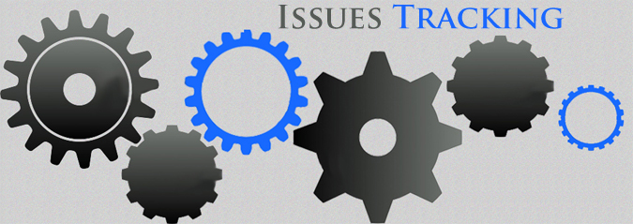
Defect Tracking
Defect Reporting and Tracking, Issue Tracking Tools, Defect Lifecycle

Slide 10
Defect Tracking
QA engineers / testers aim to find defects (bugs)
Once a defect is found, it is recorded and tracked in the defect tracking system (issue tracker) until resolved
Defect lifecycle:
A new defect is recorded in the tracker (status "new")
A developer takes a defect to work on (status "assigned")
A developers fixes a defect (changes its status to "fixed")
The QA verifies a defect is fixed and closes it (status "closed")

Slide 11
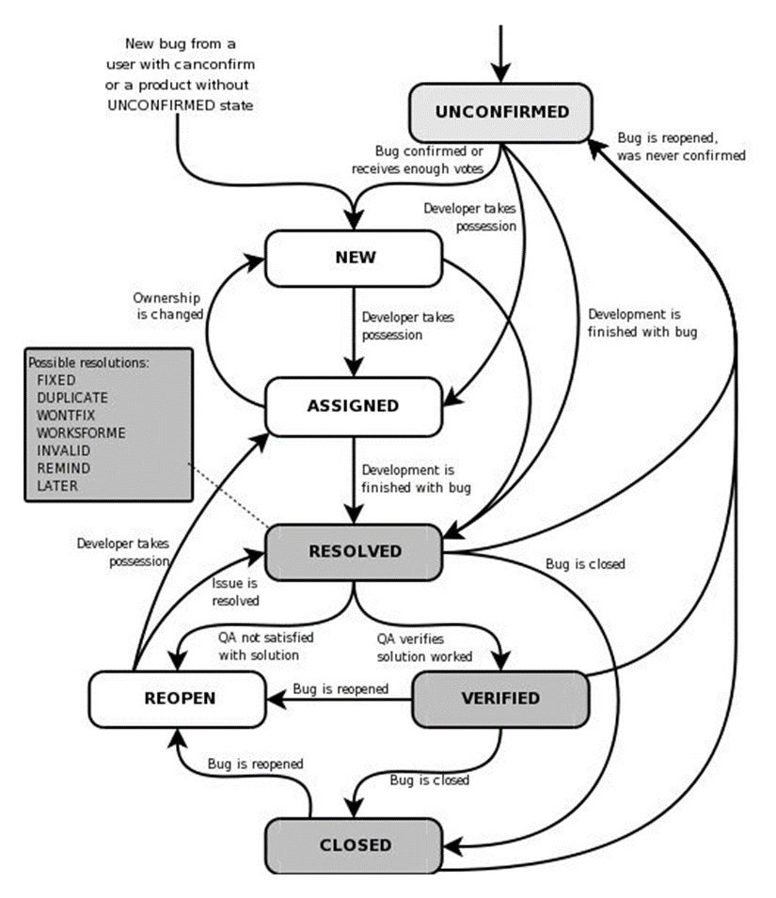
Defect Lifecycle
Defect lifecycle could be complex
Many ways to resolve a defect:
Fixed
Duplicate
Won't fix
Invalid
Etc.

Slide 12
Defects – Description
Each defect (bug / issue) holds the following information
Title: Cannot register user "maria"
Description: Registering with user "maria" and password "m1RI@" fails with message "Database connect failed…"
Screenshots: Screenshots of the problem and file attachments
Status: Assigned (assigned to a certain developer for investigation)
Owner: Peter (the developer who currently works on this issue)
Comments: People can discuss and comment the issue
Priority: Critical, High, Average, Low
Example: http://trac.edgewall.org/ticket/2463

Slide 13




Defect Tracking Systems / Issue Trackers
Many issue tracking systems are available
TRAC – http://trac.edgewall.org
Bugzilla – http://www.bugzilla.org
JIRA – https://www.atlassian.com/software/jira
GitHub Issue Tracker – https://github.com/issues

Slide 14

Test Automation
Web Testing, UI Testing, Service Testing and Load Testing Automation Tools

Slide 15
Test Automation
Test automation means:
Record test cases as scripts and execute them continuously
Makes the manual testing process repeatable
Needs time to record and write the tests
Saves time when a test is run many times over the years
Test automation: developers or QA job?
Unit tests – test a single method / class, written by developers
Integration tests – test more complex scenarios, written by QAs

Slide 16
Selenium – Web Testing Automation
Web testing can be automated by many tools
Selenium, CasperJS, many paid tools
Selenium is a leading open-source browser automation
Selenium IDE – web test recording software
Selenium WebDriver – executes browser automation scripts
Provides C#, Java and other APIs
Selenium is open-source software: http://seleniumhq.org

Slide 17
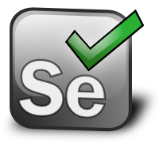
Selenium IDE + Web Driver
Live Demo

Slide 18
Sikuli – UI Testing Automation
Sikuli automates testing of anything you see on the screen
It can test desktop, Web and other applications written in any language (e.g. C#, Java, Python, PHP, …)
Sikuli works by image matching
Finds an image (e.g. the username field), clicks on it, types text, submits buttons, expect some text / image
Provides Python, Ruby and Java API
Sikuli is open-source software: http://www.sikuli.org

Slide 19
SoapUI – Web Service Testing Automation
SoapUI is open-source tool for Web service test automation
Tests REST services (HTTP, REST, JSON)
Tests SOAP services (SOAP, WSDL, XML)
http://www.soapui.org
Writing SoapUI tests
Define a service call: endpoint, parameters, headers, data, etc.
Execute the service and get the results
Check the results and compare with expected

Slide 20
JMeter – Performance Testing
JMeter is Java-based open source tool for
Load testing functional behavior and measure performance
Open-source software: http://jmeter.apache.org
How it works?
Record test scenario (e.g. login, go to dashboard, create a report, post a new issue, logout)
Replay the test scenario with 100 concurrent connections
Measure the performance (average server response time)

Slide 21







Software Quality Assurance
https://softuni.bg/courses/high-quality-code/

Slide 22

License
This course (slides, examples, demos, videos, homework, etc.) is licensed under the "Creative Commons Attribution-NonCommercial-ShareAlike 4.0 International" license
Attribution: this work may contain portions from
"High Quality Code" course by Telerik Academy under CC-BY-NC-SA license

Slide 23





Free Trainings @ Software University
Software University Foundation – softuni.org
Software University – High-Quality Education, Profession and Job for Software Developers
softuni.bg
Software University @ Facebook
facebook.com/SoftwareUniversity
Software University @ YouTube
youtube.com/SoftwareUniversity
Software University Forums – forum.softuni.bg

